Slide 1

Credit Card Fraud Detection Analysis
Presented By:- Pankti Patel

Slide 2

Introduction to Credit Card Fraud
Company ABC, a major credit card provider, is facing significant challenges with its existing fraud detection system. The current system struggles to quickly recognize new patterns of fraud, which has led to considerable financial losses and reputational risks.
To address these issues, the company requires a more efficient, responsive, and scalable solution that can adapt to evolving fraudulent behaviors. Our task is to design and implement a machine learning algorithm that can accurately detect and flag potentially fraudulent transactions for further investigation. The solution must:
Handle the imbalance between fraudulent and non-fraudulent transactions.
Be capable of adapting to new fraud patterns with minimal human intervention.
Provide faster, more accurate fraud detection to mitigate financial losses.
To achieve this, we will employ a combination of Random Forest Classifier for supervised fraud detection and Isolation Forest for unsupervised anomaly detection. This hybrid approach ensures that both known and emerging fraudulent behaviors can be flagged promptly.

Slide 3

Information about Dataset
Credit Card Fraud Detection.csv
credit_card : Unique identifier for each transaction. city: The city where the transaction occurred
state : The state or region where the transaction occurred
zipcode : The postal code of the transaction location
credit_card_limit : The credit limit associated with the credit card used in the transaction
Transaction.csv
credit_card : Unique identifier for each transactions
date : The date of the transaction (between August 1st and October 30th)
transaction_dollar_amount : The dollar amount of the transaction
Long : The longitude coordinate of the transaction location
Lat : The latitude coordinate of the transaction location

Slide 4




Project Workflow
Data Preprocessing
Load and explore the dataset, handle missing values, and prepare the data for modeling.
Handling Imbalanced Data
Fraud detection data is often highly imbalanced, so we’ll handle this using techniques like SMOTE (Synthetic Minority Over-sampling Technique).
Feature Scaling
Normalize the data for better model performance.
Model Training and Evaluatio
Train the Random Forest model and evaluate it, followed by using Isolation Forest for anomaly detection.

Slide 5
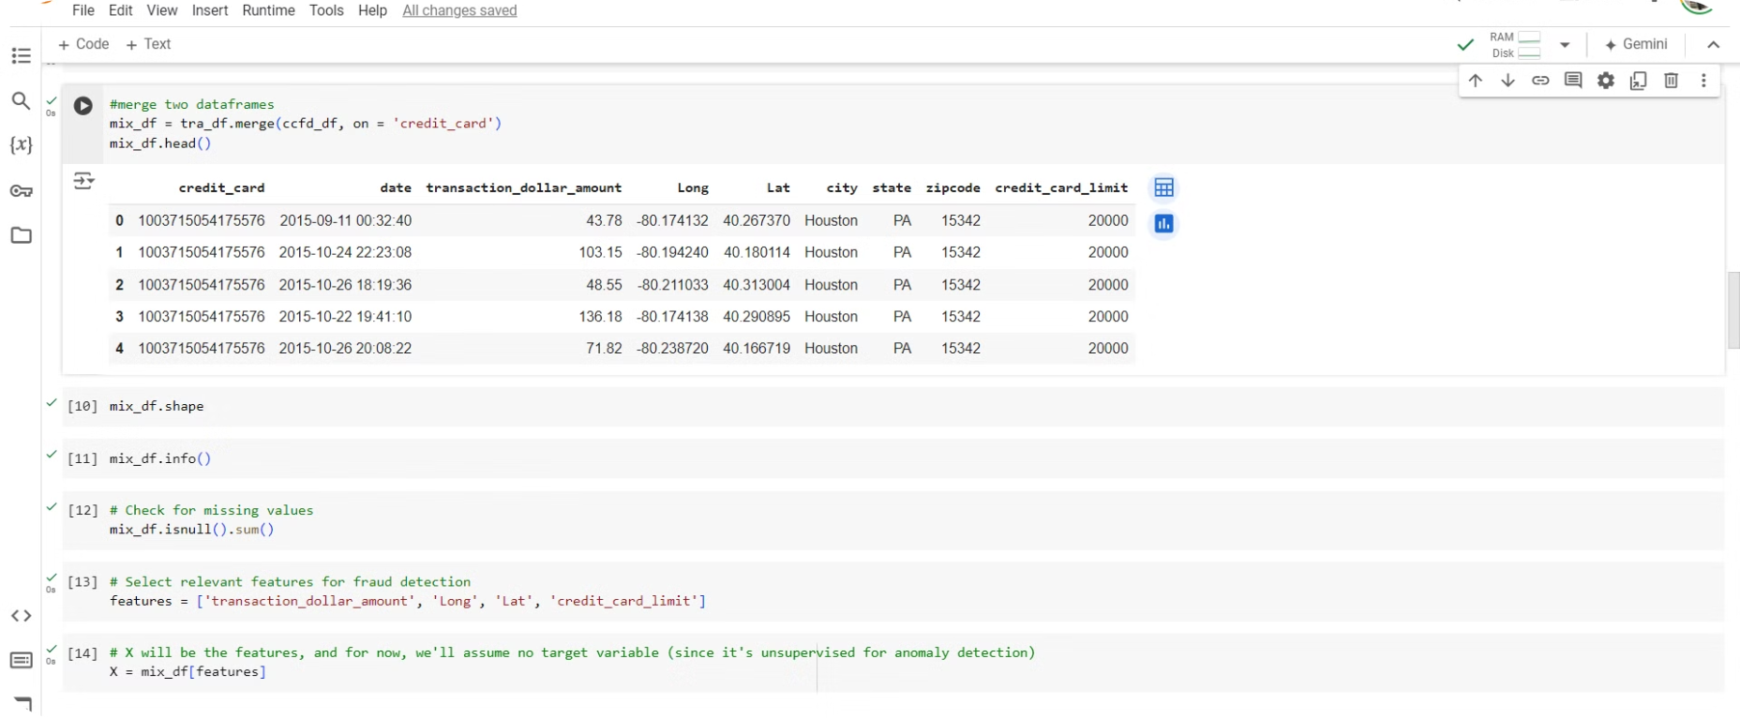
Data Preprocessing and Cleaning
1
2
3
I merged the datasets and handled any missing values to clean up the data.
Selected key features for fraud detection: transaction amount, credit card limit, and location (longitude and latitude).
This step helps make sure that the data is ready for machine learning models.

Slide 6

Handling Imbalanced Data
Fraud detection data is typically imbalanced, To handle this first I split the data into training and testing sets. Then used SMOTE (Synthetic Minority Over-sampling Technique) to balance the dataset by oversampling fraud cases

Slide 7

Feature Scaling
After balancing the data, I applied StandardScaler to normalize the features.
Scaling ensures that the model treats all features equally, especially when features like transaction amount are on different scales than location coordinates.
Normalizing the data makes it easier for the model to find patterns and improve accuracy.

Slide 8



Model Training and Evaluation
Random Forest Classifier (Supervised)
Models trained on labeled data to identify patterns associated with fraudulent transactions.
Isolation Forest (Unsupervised Anomaly Detection)
Models identify anomalies in data without explicit labels, identifying unusual spending patterns.

Slide 9

Random Forest Classifier
I used a Random Forest Classifier to classify transactions as fraud or not based on simulated labels.
Random Forest is great because it builds multiple decision trees and averages the results to make more accurate predictions.
After training, I evaluated the model using accuracy, precision, recall, and F1-score. The results were shown in a confusion matrix.

Slide 10

Isolation Forest (Anomaly Detection)
Since there were no real fraud labels in my dataset, I used Isolation Forest to catch anomalies.
Isolation Forest identifies transactions that are different from normal transactions and flags them as potential fraud.
I set the contamination rate to 1%, meaning that around 1% of transactions were flagged as potential fraud. These transactions are worth further investigation.

Slide 11
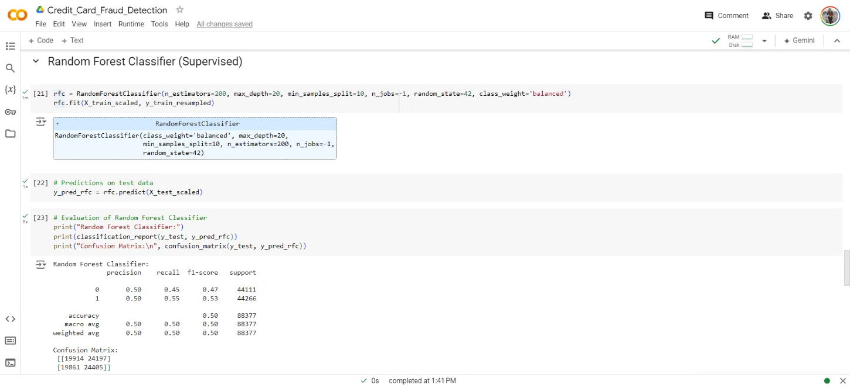
Random Forest Classifier Output

Slide 12
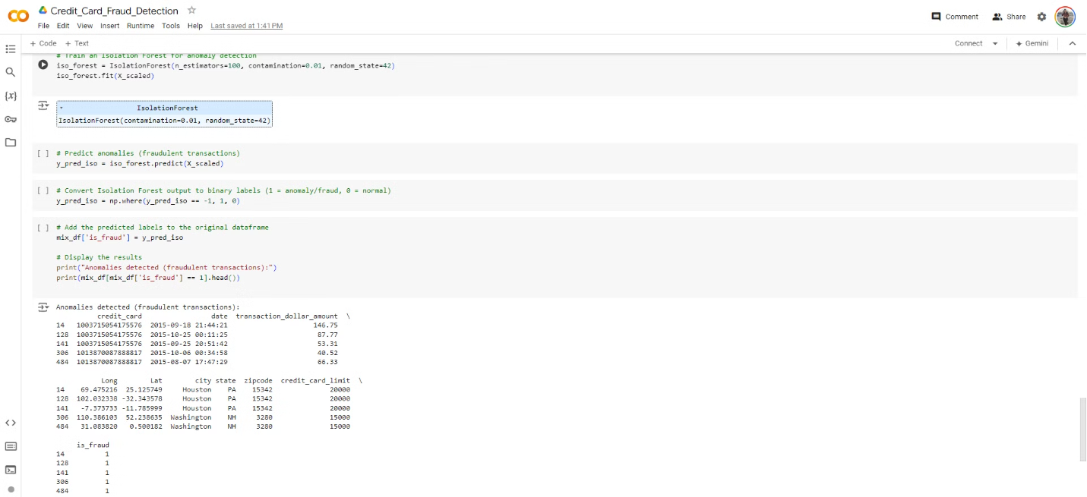
Isolation Forest Output

Slide 13

Thank You

